Slide 1
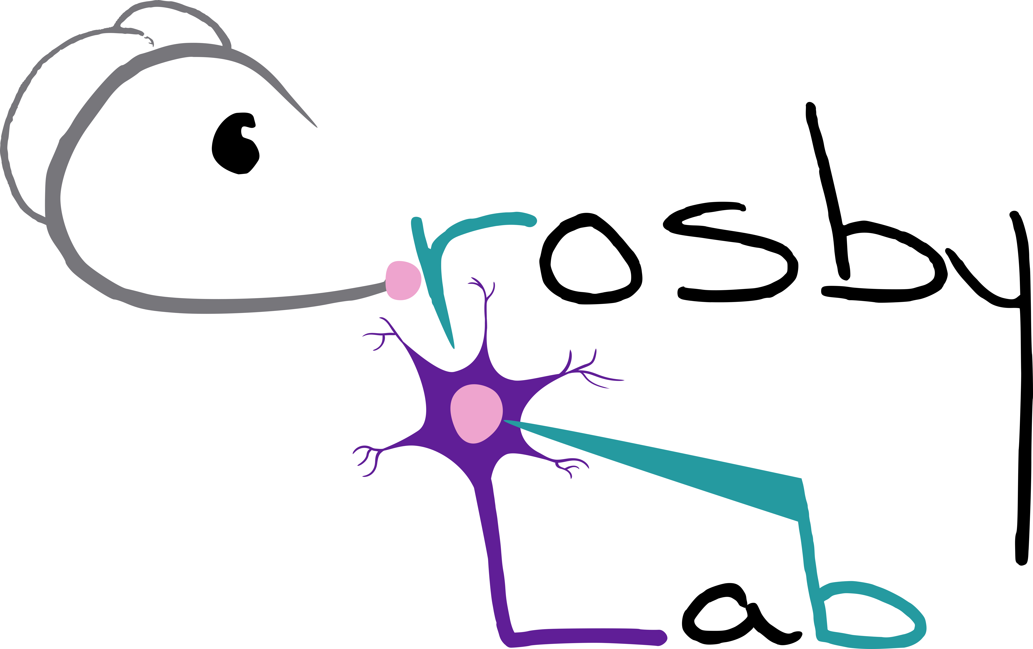

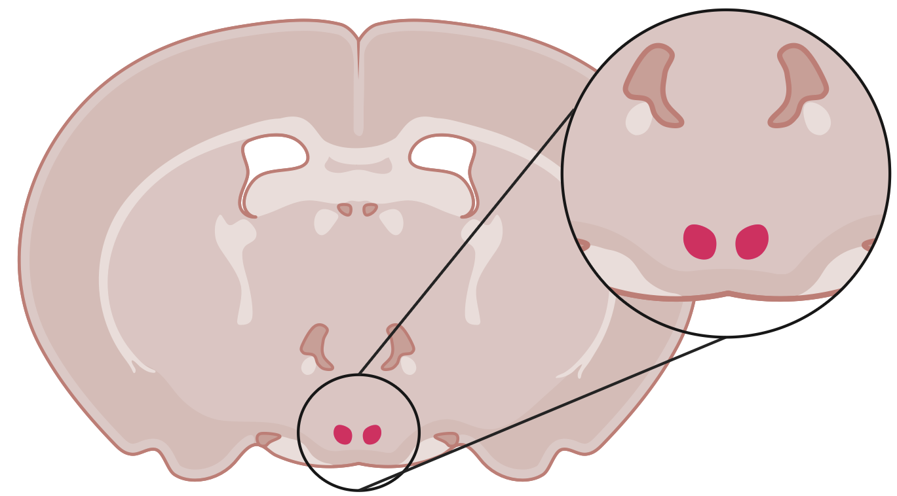
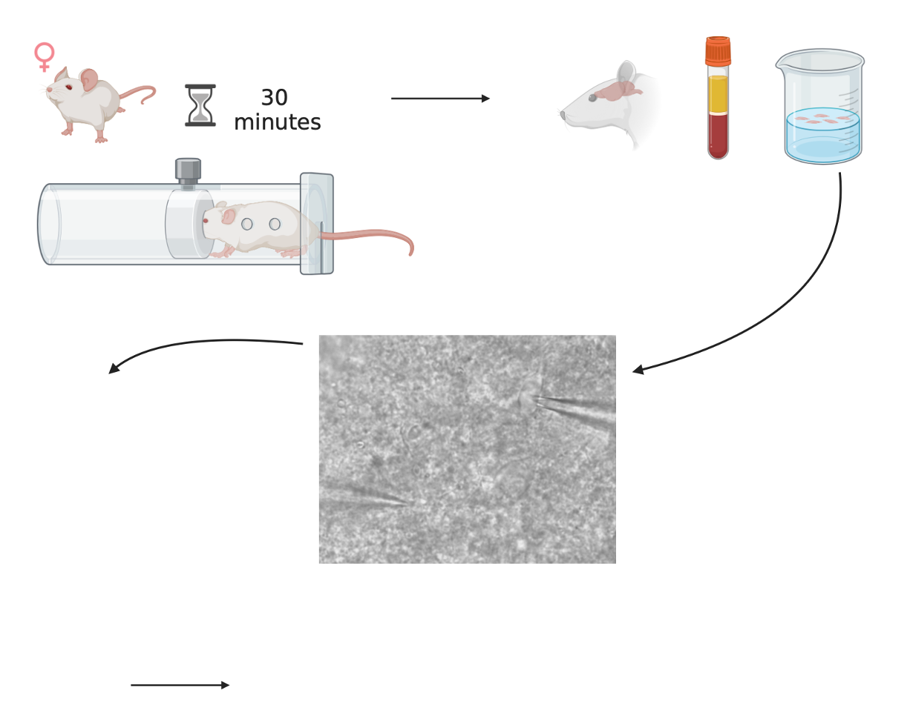
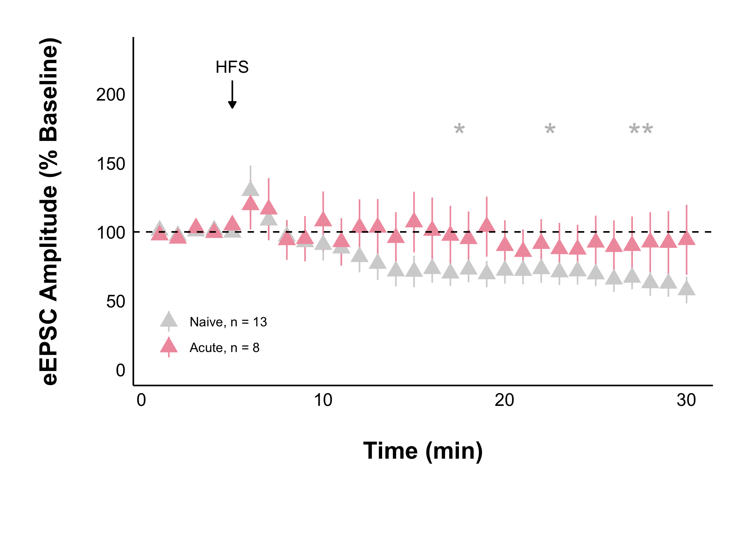
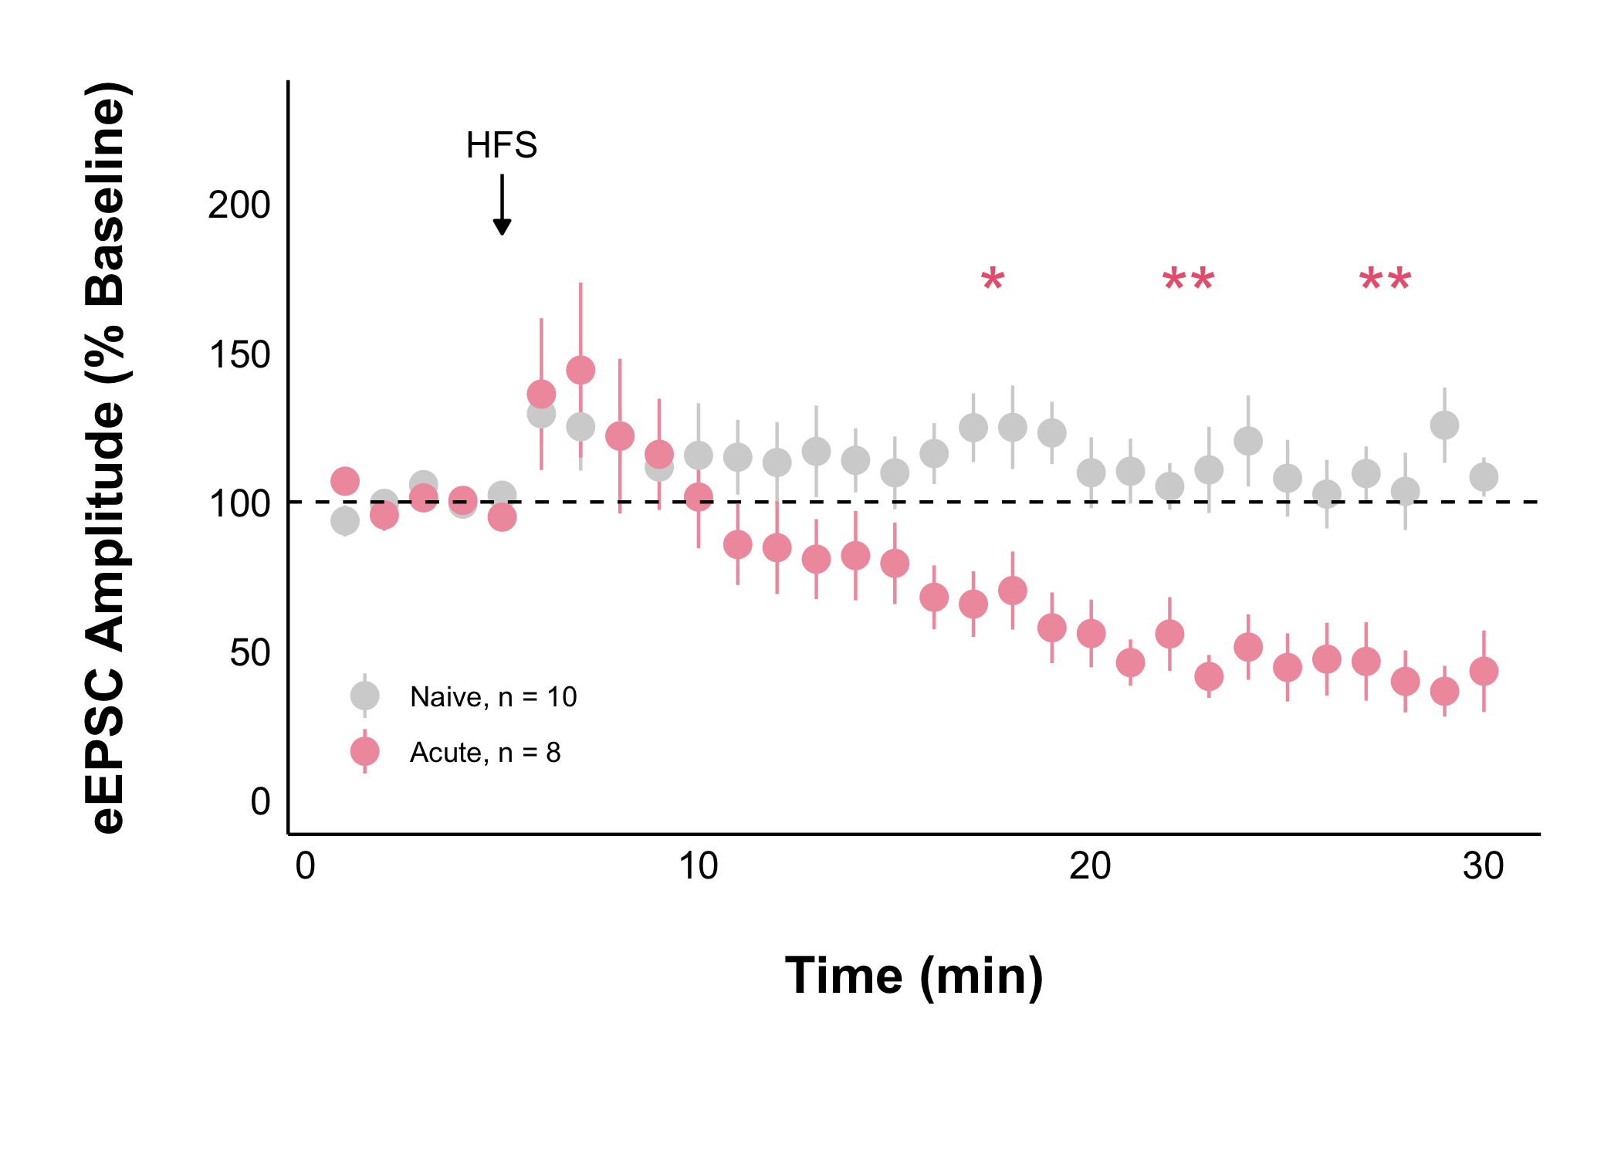
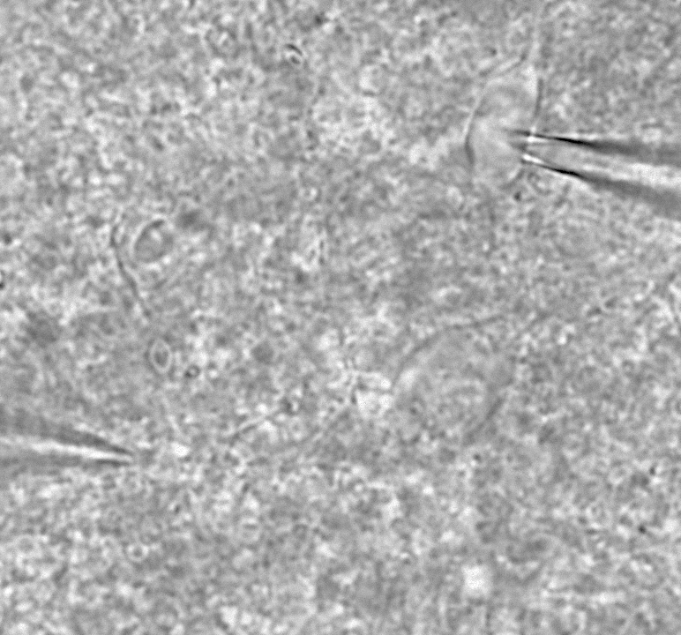
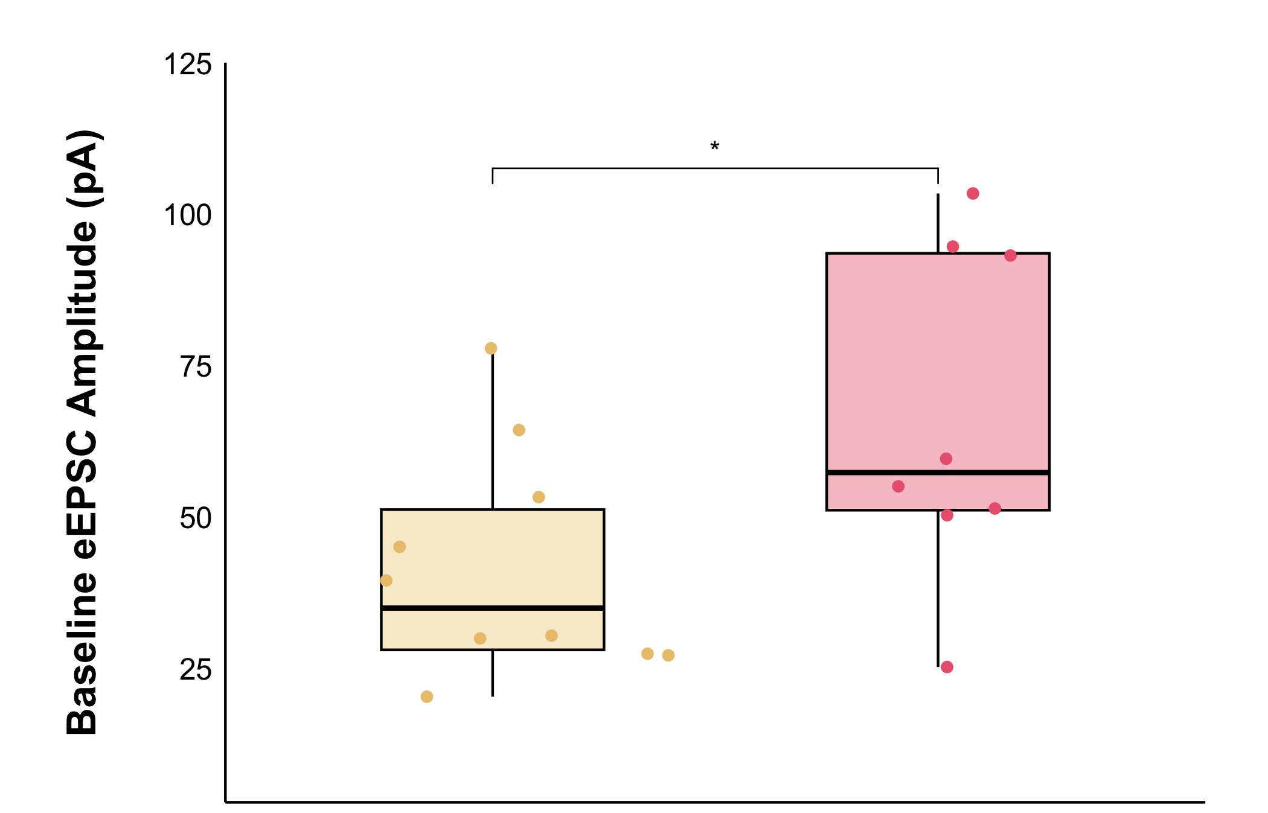
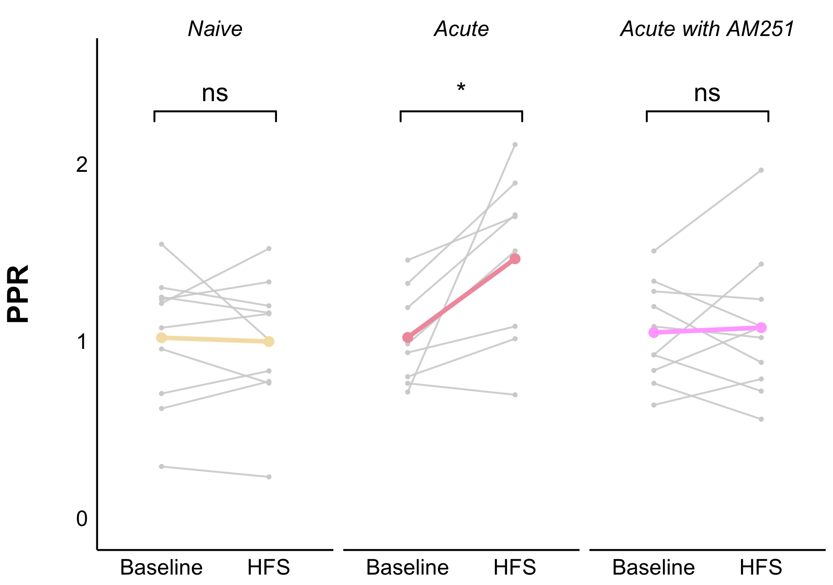
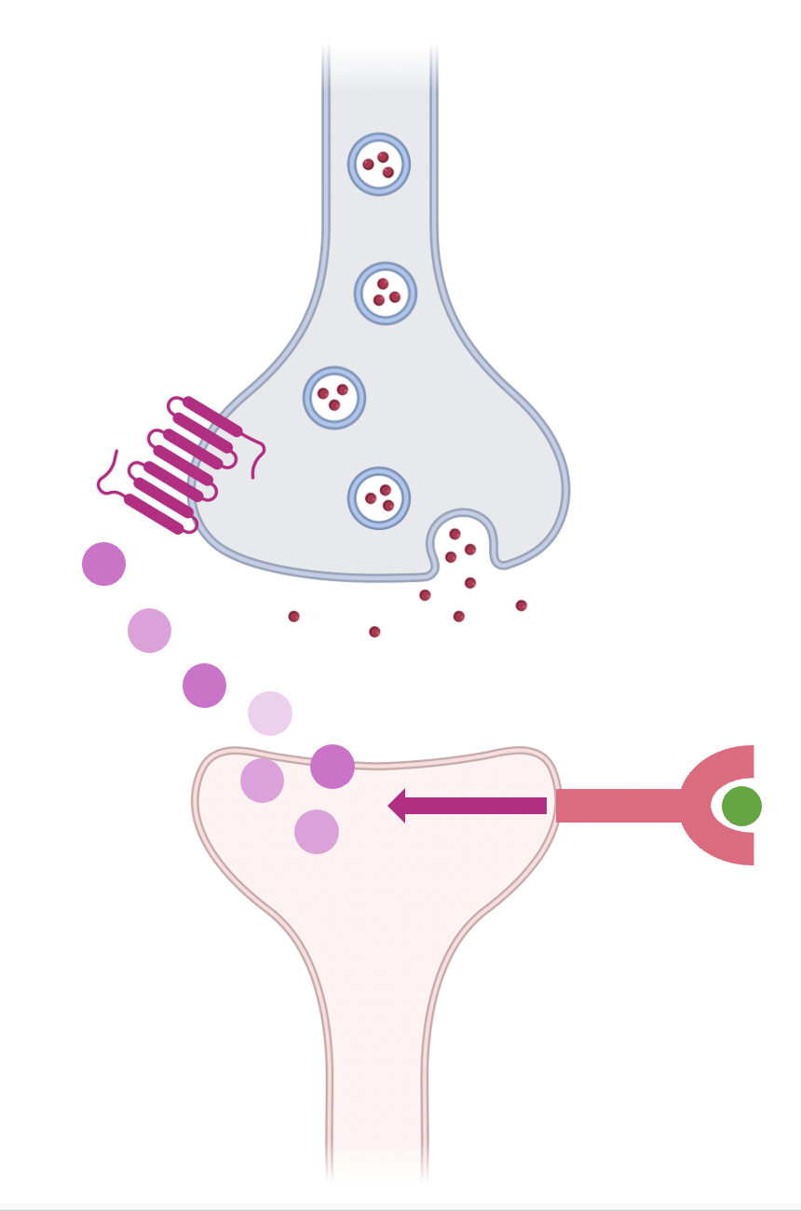
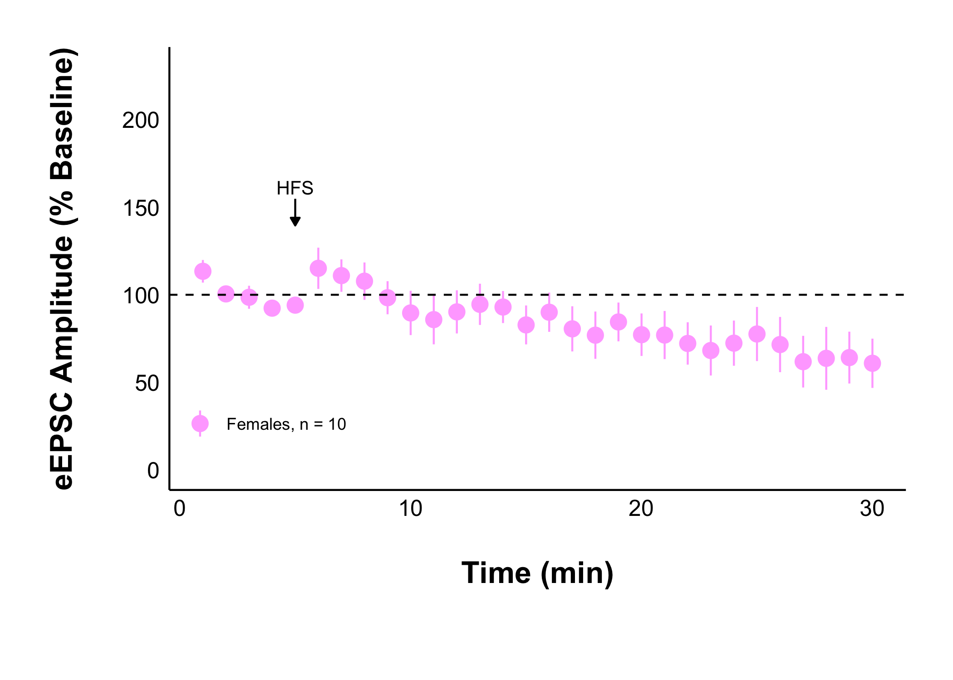

Acute Stress Decreases Glutamate Transmission in the Female Rat
Dorsomedial Hypothalamus
Ruby Muzzatti, Sarah Wilson, Lara Swart, Dr Karen Crosby
Department of Biology, Mount Allison University, Sackville, New Brunswick, Canada
BACKGROUND
METHODS
Stress response mechanisms have not adapted to our high stress society and landscape of high calorie, highly palatable foods¹. Women are particularly vulnerable to disordered eating behaviours when stressed², for which the neurophysiological basis is unclear. Yet, female research subjects remain underrepresented.
The dorsomedial hypothalamus (DMH) is a brain region involved in appetite and body weight regulation³, and the stress response⁴. Some DMH neurons increase appetite and have receptors for stress hormones⁵. How stress affects DMH neurons is unclear.
Experiments were performed according to protocol #104140 approved by the Mount Allison University Animal Care Committee in accordance with the Canadian Council on Animal Care Guidelines
Young, female Sprague-Dawley rats were exposed to a single restraint stress
They were anesthetized, euthanized, and their brains were quickly removed
How acute stress in females affects glutamatergic transmission in the DMH is unknown.
RESULTS
A blood sample was collected
How does acute stress in females affect baseline glutamate transmission?
What about long term changes?
250 µm
coronal brain slices containing the DMH were kept alive in oxygenated artificial cerebrospinal fluid kept at 32.5 ℃
Male
Female
Recording electrode inserted into DMH neurons, and a stimulating electrode into surrounding tissue to evoke excitatory postsynaptic currents (eEPSC) at 0.2 Hz
*
Naive
Acute
Living neurons were recorded from before and after high frequency stimulation (HFS) to observe long-lasting changes
50 µM picrotoxin was applied to observe glutamate synapses
An unpaired t-test was to compare between groups.
* = p-value < 0.05
Naive female data collected by Lara Swart, male data collected by Sarah Wilson.
A paired t-test was used to compare each 5-minute interval to the 5-minute baseline period.
* = p-value < 0.05, ** = p-value < 0.01
There is a significant increase in eEPSC amplitude.
Acute stress in females triggered a long-lasting depression in glutamate transmission compared to naïve, but not in males.
HFS Protocol: 100 Hz for 4 seconds, twice, 20 seconds apart
Is the depression due to a presynaptic decrease in glutamate onto DMH neurons during acute stress?
What causes the female depression?
Data analysis was performed using patchclampplotteR by Christelinda Laureijs⁶
Endocannabinoids (eCBs) can trigger a long-lasting decrease in glutamate release.
CONCLUSIONS
*
AM251 blocks CB1 receptors (CB1R).
CB1R
There are sex differences in glutamate transmission in the rat DMH.
Females who are acutely stressed have more glutamate transmission onto DMH.
There is a long-lasting decrease in glutamate current amplitude and probability of presynaptic glutamate release under acute stress.
The decreases in eEPSC amplitude and presynaptic glutamate release during acute stress are no longer significant when endocannabinoid-CB1 receptors are blocked.
Acute Female with 5 µM AM251
eCBs
Cortisol binds to glucocorticoid receptors
DMH neuron
FUTURE DIRECTIONS
When eCB-CB1 receptors are blocked there is no longer a long-lasting decrease in glutamatergic current amplitude under acute stress.
Future work aims to determine:
The effect of chronic (repeated) stress (work in progress) on the female rat DMH.
How corticosterone is involved in the change in glutamate transmission under acute stress.
The effect of stress on neuronal excitability.
A paired t-test was used to compare between baseline and post HFS.
The PPR is calculated as the evoked current amplitude of peak 2/peak 1.
The PPR significantly increased, indicating a lower probability of glutamate release onto DMH neurons under acute stress, but there is no change in PPR when eCB-CB1 receptors are blocked under acute stress.
REFRENCES
Schematic Images created using BioRender.
Dallman MF, Pecoraro NC, La Fleur SE, et al. Glucocorticoids, chronic stress, and obesity. In: Progress in Brain Research. Vol 153. Elsevier; 2006:75-105. doi:10.1016/S0079-6123(06)53004-3
Adam TC, Epel ES. Stress, eating and the reward system. Physiology & Behavior. 2007;91(4):449-458. doi:10.1016/j.physbeh.2007.04.011
Bellinger LL, Bernardis LL. The dorsomedial hypothalamic nucleus and its role in ingestive behavior and body weight regulation. Physiology & Behavior. 2002;76(3):431-442. doi:10.1016/S0031-9384(02)00756-4
Crosby KM, Bains JS. The intricate link between glucocorticoids and endocannabinoids at stress-relevant synapses in the hypothalamus. Neuroscience. 2012;204:31-37. doi:10.1016/j.neuroscience.2011.11.049
Cintra A, Fuxe K, Wikstro¨m AC, Visser T, Gustafsson JA. Evidence for thyrotropin-releasing hormone and glucocorticoid receptor-immunoreactive neurons in various preoptic and hypothalamic nuclei of the male rat. Brain Research. 1990;506(1):139-144. doi:10.1016/0006-8993(90)91210-8
Laureijs C. patchclampplotteR: Plot and Analyze Raw Patch Clamp Electrophysiology Data [R package]. Version 0.1.0. 2025
ACKNOWLEDGMENTS
I want to thank my supervisor, Dr Crosby, for her continued guidance and support. I want to express my gratitude to Jackie Jacob-Vogels for her dedication to and passion for incredible animal care, from which I have learned so much.
This project was supported by a Mount Allison University Independent Student Research Grant (ISRG) and a Natural Science and Engineering Research Counsil of Canada (NSERC) Undergraduate Student Research Award (USRA).
Notes:
NEW:
1: Dallman et al., 2006
2: Adam and Epel 2007
3: Bellinger and Bernardis, 2002
4: Crosby and Bains, 2012
5: Cintra et al., 1990
.

